Slide 1
Machine Learning II
Lecture 6 – Activation function and overfitting
https://chatbotslife.com/regularization-in-deep-learning-f649a45d6e0

Slide 2
Introduction
What we saw last week…
Backpropagation and feedforward network
Keras first code
What we will see this week …
Activation functions
Overfitting
Before we start:
A model parameter is a configuration variable that is internal to the model and its value can be estimated from data.
A model hyperparameter is a configuration that is external to the model and its value cannot be estimated from data.

Slide 3
Parameters
A model parameter is a configuration variable that is internal to the model and whose value can be estimated from data.
They are required by the model when making predictions.
They values define the skill of the model on your problem.
They are estimated or learned from data.
They are often not set manually by the practitioner.
They are often saved as part of the learned model.
Example:
The weights in an artificial neural network.
The support vectors in a support vector machine.
The coefficients in a linear regression or logistic regression.
https://machinelearningmastery.com/difference-between-a-parameter-and-a-hyperparameter/

Slide 4
Hyperparameters
A model hyperparameter is a configuration that is external to the model and whose value cannot be estimated from data.
They are often used in processes to help estimate model parameters.
They are often specified by the practitioner.
They can often be set using heuristics.
They are often tuned for a given predictive modeling problem.
Example:
The learning rate for training a neural network.
The C and sigma hyperparameters for support vector machines.
The k in k-nearest neighbors.
https://machinelearningmastery.com/difference-between-a-parameter-and-a-hyperparameter/

Slide 5
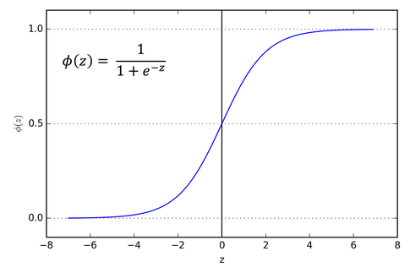

sigmoid activation
Sigmoid or logistic regression activation ($σ$): The Sigmoid Function curve looks like a S-shape that is changed between zero to one.
$$σ\left(x\right)=\frac{1}{1+e^{−x}}$$
The function is monotonic while its derivative is not monotonic.
It can replicate the performance of a probability for prediction.

Slide 6
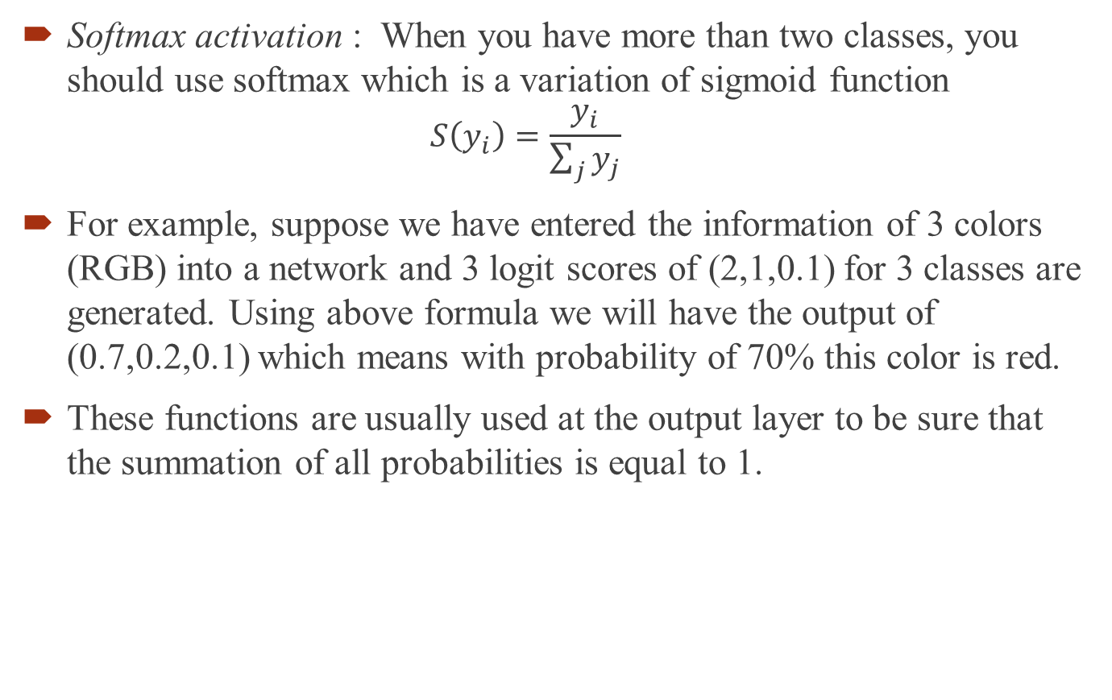
softmax activation
Softmax activation : When you have more than two classes, you should use softmax which is a variation of sigmoid function
$$S\left(y_{i}\right)=\frac{y_{i}}{\sum_{j}{y_{j}}}$$
For example, suppose we have entered the information of 3 colors (RGB) into a network and 3 logit scores of (2,1,0.1) for 3 classes are generated. Using above formula we will have the output of (0.7,0.2,0.1) which means with probability of 70% this color is red.
These functions are usually used at the output layer to be sure that the summation of all probabilities is equal to 1.

Slide 7
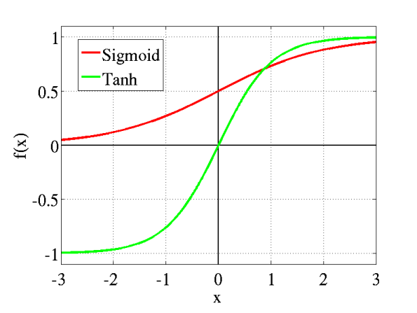

tanh activation
hyperbolic tangent (tanh): The shape is similar to sigmoid but it is changed between -1 and 1.
$$tanh\left(x\right)=\frac{e^{x}−e^{−x}}{e^{x}+e^{−x}}$$
The function is monotonic while its derivative is not monotonic.
The tanh function is mainly used for classification between two classes.
Since tanh is centered around zero, its gradient is more efficient and we prefer it to sigmoid.

Slide 8
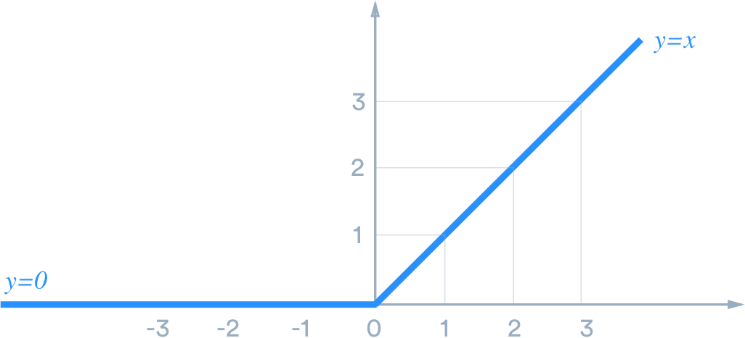

ReLU activation
Rectified Linear Unit (ReLU): Only considers the positive part of the function.
$$f\left(x\right)= \max_{}{(0,x)}$$
It was developed on 2000 and was used to train deep networks as of 2011.

Slide 9
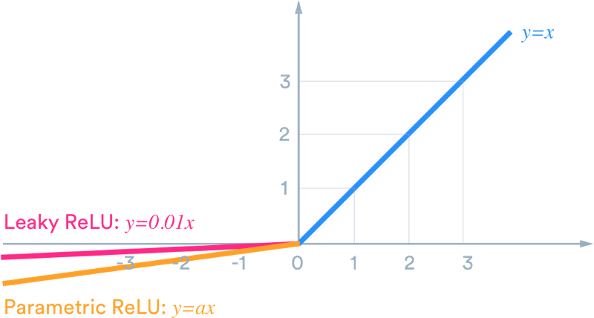
ReLU activation
Pros:
Easier to train only 50% of neurons are activated in initial step(sparse activation)
Computations are easier (no need to exp or power)
Has less vanishing gradient problem (the problem that happens due to partial derivatives of other functions which is escalated by chain rule)
Cons:
Non-differentiable at zero
Unbounded
Dying neurons (sometimes we stuck in zero phase and never exits from that state). Solution is leaky ReLU

Slide 10
Overfitting of the NN
Since we have plenty of parameters to train in a NN, it can easily fall in overfitting.
What are the solutions?
Regularization? Do you remember?
Reducing number of features
Increasing number of observations- instances
Regularization is one method of handling overfitting (high variance) problem.
In general there are two methods of regularization L1 and L2
Since the goal in regularization is to control the effect of weight, it is also called “weight decay”

Slide 11
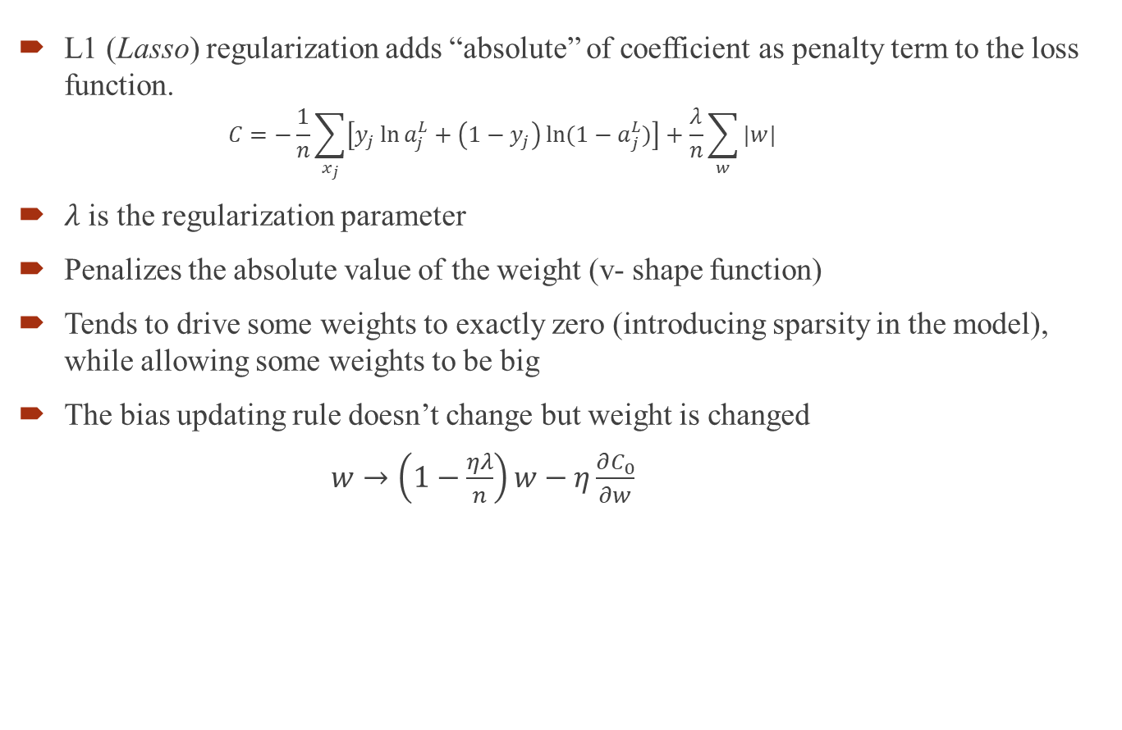
L1 regularization
L1 (Lasso) regularization adds “absolute” of coefficient as penalty term to the loss function.
$$C=−\frac{1}{n}\sum_{x_{j}}{\left[y_{j}\ln{a_{j}^{L}}+\left(1−y_{j}\right)\ln{{(1−a}_{j}^{L})}\right]}+\frac{λ}{n}\sum_{w}{|w|}$$
$λ$ is the regularization parameter
Penalizes the absolute value of the weight (v- shape function)
Tends to drive some weights to exactly zero (introducing sparsity in the model), while allowing some weights to be big
The bias updating rule doesn’t change but weight is changed
$w→\left(1−\frac{ηλ}{n}\right)w−η\frac{∂C_{0}}{∂w}$

Slide 12
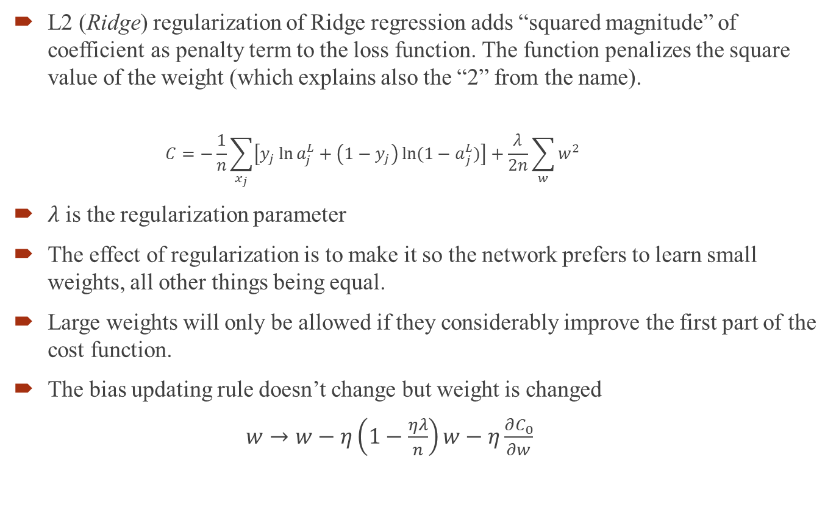
L2 regularization
L2 (Ridge) regularization of Ridge regression adds “squared magnitude” of coefficient as penalty term to the loss function. The function penalizes the square value of the weight (which explains also the “2” from the name).
$$C=−\frac{1}{n}\sum_{x_{j}}{\left[y_{j}\ln{a_{j}^{L}}+\left(1−y_{j}\right)\ln{{(1−a}_{j}^{L})}\right]}+\frac{λ}{2n}\sum_{w}{w^{2}}$$
$λ$ is the regularization parameter
The effect of regularization is to make it so the network prefers to learn small weights, all other things being equal.
Large weights will only be allowed if they considerably improve the first part of the cost function.
The bias updating rule doesn’t change but weight is changed
$w→w−η\left(1−\frac{ηλ}{n}\right)w−η\frac{∂C_{0}}{∂w}$

Slide 13
Dropout
In dropout technique (developed 2014), at each training iteration a dropout layer randomly removes some nodes in the network along with all of their incoming and outgoing connections.
Dropout can be applied to hidden or input layer.
Despite L1 and L2 regularizations, rather than working on cost function, we modify the whole network.
In dropout technique we identify the percentage of the neurons that we want to keep.
One time we train with whole network, then randomly drop neurons and compute the parameters of network. This random dropped out neurons will be repeated randomly.

Slide 14
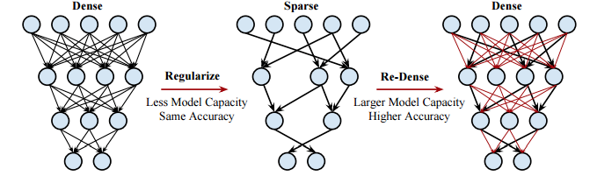
Dense-sparse-dense training
The technique (developed 2016) consists in 3 steps:
Perform initial regular training, but with the main purpose of seeing which weights are important, not learning the final weight values.
Drop the connections where the weights are under a particular threshold. Retrain the sparse network to learn the weights of the important connections.
Make the network dense again and retrain it using small learning rate, a step which adds back capacity.

Slide 15
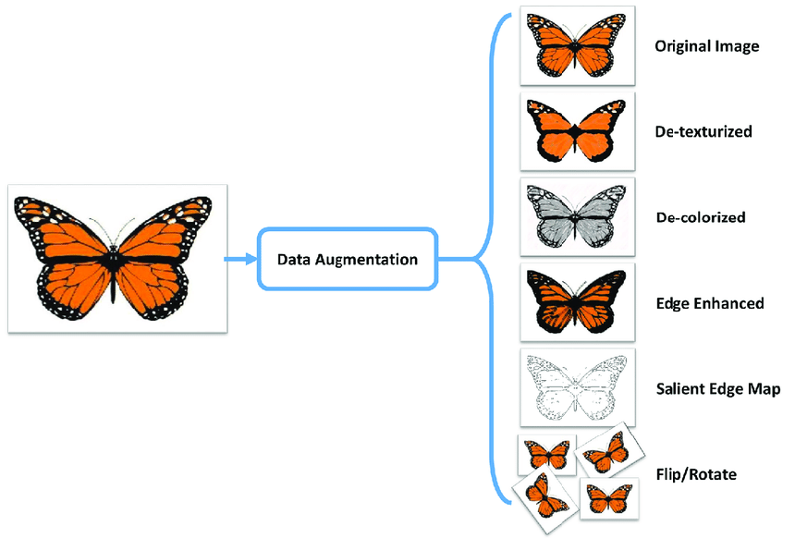
Data augmentation
As we discussed, one way of handling the overfitting is having more instances.
There is no general recipe regarding how the synthetic data should be generated and it varies a lot from problem to problem.
For images some common techniques include translating the picture a few pixels, rotation, scaling. For classification problems it’s usually feasible to inject random negatives — e.g. unrelated pictures.

Slide 16
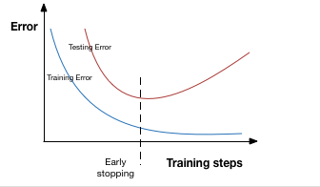
Early stopping
Early stopping is effectively tuning the hyper-parameter number of epochs/steps.
While the model is trained, both train and test learning curves follow each other. There is a point where test error starts to leave train curve. This is the point that is called early stopping and the goal of the algorithm is to find this point.
In practice, instead of actually stopping, people usually setup checkpoints to save the model at regular time intervals with continuous learning and pick the best candidate after the fact.

Slide 17
Keras commands- examples
Regularization:
Or
Decay in sgd function
Drop out:
keras.layers.Dropout(rate)
from keras import regularizers
model.add(Dense(64, input_dim=64, kernel_regularizer=regularizers.l2(0.01))

Slide 18
Keras exmaple
from tensorflow.keras.models import Sequential
from tensorflow.keras.layers import Dense
from tensorflow.keras import optimizers
def baseline_model():
# create model
model = Sequential()
model.add(Dense(50, input_dim=num_pixels, activation='tanh'))
model.add(Dense(50, activation='tanh'))
model.add(Dense(num_classes, activation='softmax'))
sgd = optimizers.SGD(lr=0.1, decay=1e-7)
model.compile(loss='categorical_crossentropy', optimizer=sgd, metrics=['accuracy'])
return model

Slide 19
Keras exmaple
model = baseline_model()
# Fit the model
nn_simple = model.fit(X_train, y_train, validation_data=(X_test, y_test), epochs=25, batch_size=128)
# Final evaluation of the model
scores = model.evaluate(X_test, y_test)
print("Baseline Error: %.2f%%" % (100-scores[1]*100))
print("Baseline Accuracy: %.2f%%" % (scores[1]*100))

